Slide 1
WISDM for Grants Management
Last Updated: December 2016

Slide 2
WISDM for Grants Management Overview
This presentation is meant to give an overview of the use of WISDM for managing sponsored programs
A replacement system for WISDM called WISER is currently in development.

Slide 3
WISDM – What are we covering today?

Slide 4
WISDM
My Projects
List of specific projects you wish to monitor
For PIs, their list is automatically populated
Award and Project Information
Some information is only at the Award level
Sponsor name
Award reference number
Award begin and end dates
Award description
Invoicing & AR information

Slide 5
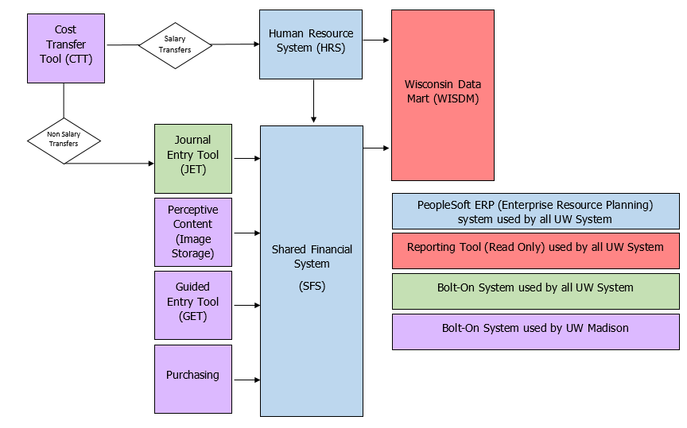
WISDM (Shared Financial System Overview)
WISDM (Wisconsin Data Mart)
Web-based reporting system
Data is loaded nightly from SFS and HRS

Slide 6
Accrual Accounting
Accrual accounting recognizes revenue as expenses are incurred
Revenue does not equal Cash
NOTE: Clinical Trials, Gifts, and other non-sponsored projects are managed on a Cash Basis

Slide 7
Award-level Information
Listing of all Projects associated with Award
Personnel: all people charged to award
Funding Actions: Awards (replaces Regent Action Notices)
Requirements: Terms and Conditions; Certifications (protocols)
Associated Docs: sponsor invoices; notice of grant awards
Pre-Award/WISPER information

Slide 8
WISDM
Project-level information is mostly financial
Project ID is used for charging expenses to grants
Project begin and end dates
Project description
Additional Award/Project search criteria
Funding Action search
WISPER/Pre-Award search

Slide 9
My Projects List
For Principal Investigators, a list of the projects for which they are the PI is automatically populated
All WISDM users can create their own My Projects list by adding projects
My Projects list accessible with one click from the menu bar when in Projects Navigation
My Projects list displays summary financial information as inception to a selected accounting period

Slide 10
My Projects List
For Investigators, this list will be populated automatically.
Other users can add and subtract projects as they wish.

Slide 11
My Projects List
Column headings allow users to sort data ascending or descending.
The default Balance Type is Budget, which includes Encumbrances.
The default reporting period is the current month.

Slide 12
My Projects List
Note: The financial balance information on this page INCLUDES F&A. To see an accurate picture of the funds available to spend, drill down on the Project ID.

Slide 13
My Projects List
The arrows and “X” allow users to move projects to a specific place in their My Projects list or delete the project from the list. Use the arrows to move the project position. The “X” deletes the project from your list.

Slide 14
My Projects List
Drill down to Award data: Award IDs start with “MSN”
Drill-down to Project data

Slide 15
Award/Project Search
NOTE: It is important that you use the new Project Search to locate current projects. Do not use the “Old Project Search” unless you must see transaction detail prior to July 2006.

Slide 16
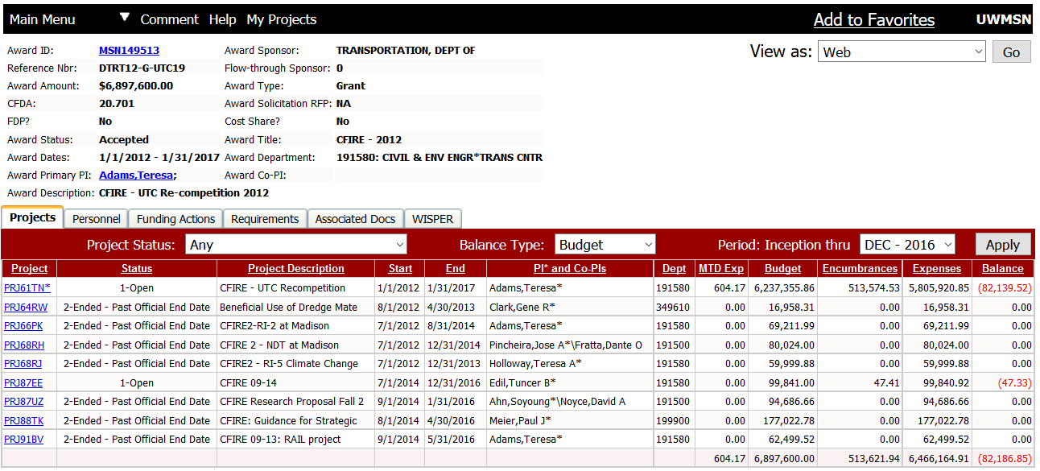
Award Summary
For Grants, demographic information is captured at the Award level. Every Award will have one or more projects.

Slide 17
Award Summary
Note: The financial balance information on this page INCLUDES F&A. To see an accurate picture of the funds available to spend, drill down on the Project ID.

Slide 18
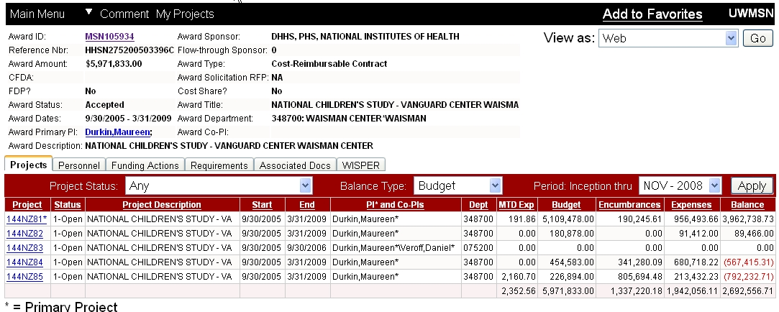
Award Summary
Award Information
Projects Associated with Award

Slide 19
Award Summary
Return to My Projects
Tabbed navigation
Tabbed navigation provides additional information. The My Projects link on the menu bar returns you to your My Projects list.

Slide 20
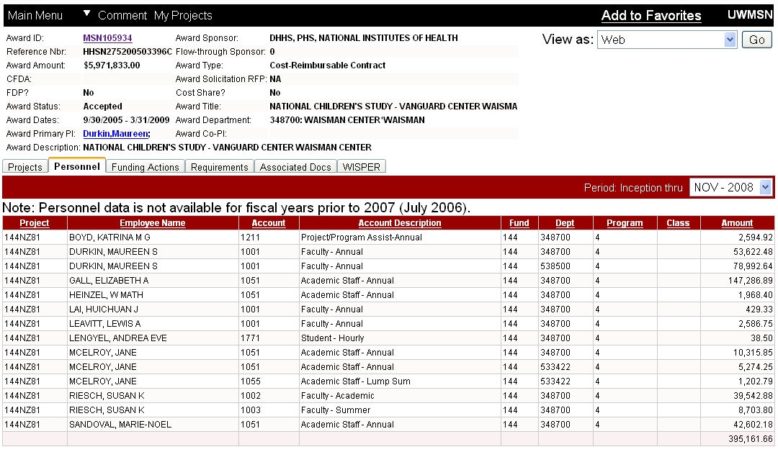
Personnel: All Individuals Paid by Salary/Stipend on an Award
Note: Column headings on these detail pages can be used to sort data

Slide 21
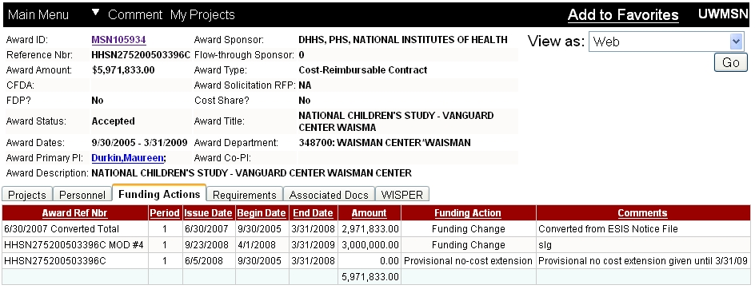
Funding Actions: Award Actions
Items in the Funding Actions tab include actions related to receiving the Notice of Award, Award Modifications, No-Cost Extensions, etc.

Slide 22
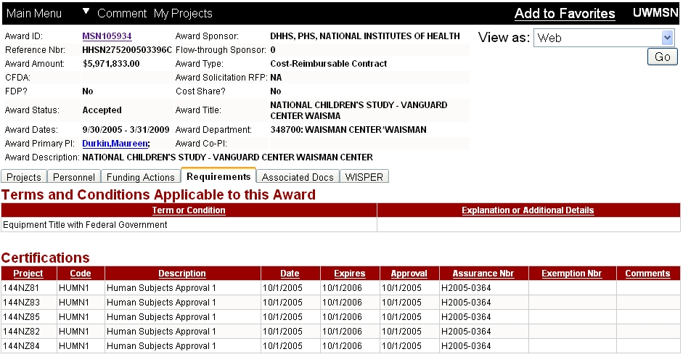
Requirements: Terms and Conditions and Certifications

Slide 23
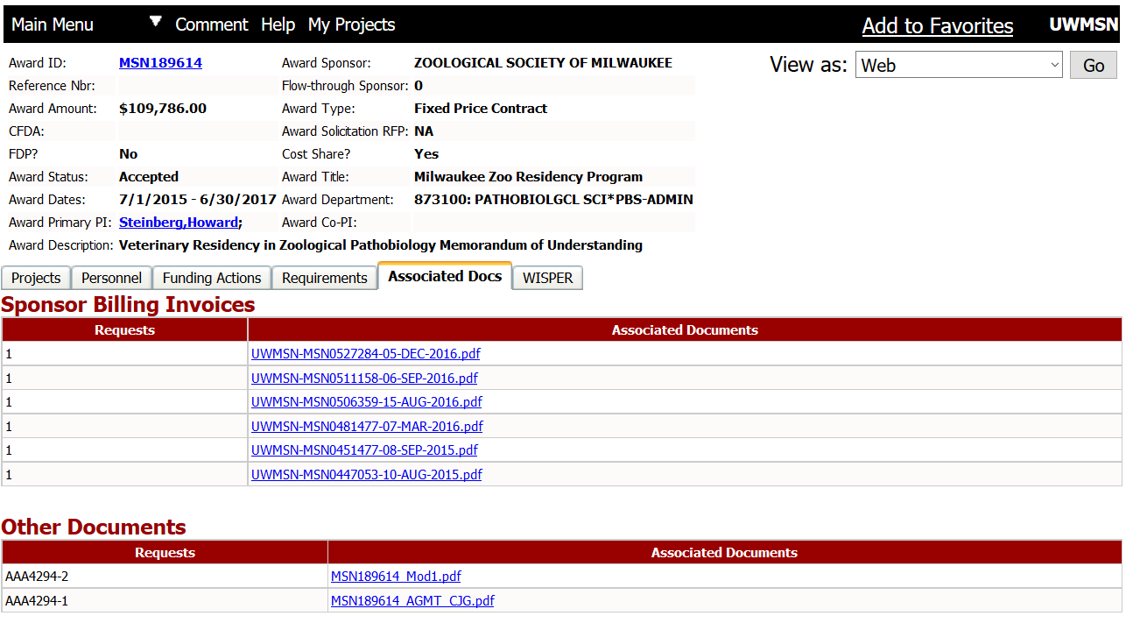
Associated Docs: Invoices and NGAs
Copies of invoices sent to the sponsor are stored under the Associated Docs tab under “Sponsor Billing Invoices”; Notifications received from the sponsor (and in some other supporting documents) are stored under “Other Documents”

Slide 24
WISPER: Information About Proposal
This represents what was originally proposed, and may contain WISPER records related to the award.

Slide 25
Project-Level Information
Project Level
Award Level
Project-Specific Information
Financial transaction summary (Financials)
Personnel paid from Project
Valid Edit information
Cost Share Schedule
Cost Share Expenditures
Award General Information
(same information as at award level)
Funding Actions
Requirements
Associated Documents
WISPER

Slide 26
Project Summary
Add/Remove from My Projects list
Navigate through My Projects list
Click Arrow to expand Award info

Slide 27
Project Summary
Expanded Award info on Project Summary (click Arrow to minimize)

Slide 28
Project Summary
Fund indicates source type
133 – Sponsored (Non Federal)
144 – Sponsored (Federal)
F&A: Facilities and Administration
May be referred to as “Overhead” or “Indirect Costs”
Costs that are necessary to support research
Include costs related to utilities, buildings, maintenance, etc.
You can find more information at the RSP page https://www.rsp.wisc.edu/rates/

Slide 29
Project Financials
There are several options for displaying financial summary data:
Balance Type- include or exclude Encumbrances
Period- change the period financial are summarized. Default is Inception to current accounting period
Account Tree- change the default reporting tree. This should normally not need to be changed for sponsored projects
Summary Level- change the level of detail displayed on the summary page.

Slide 30
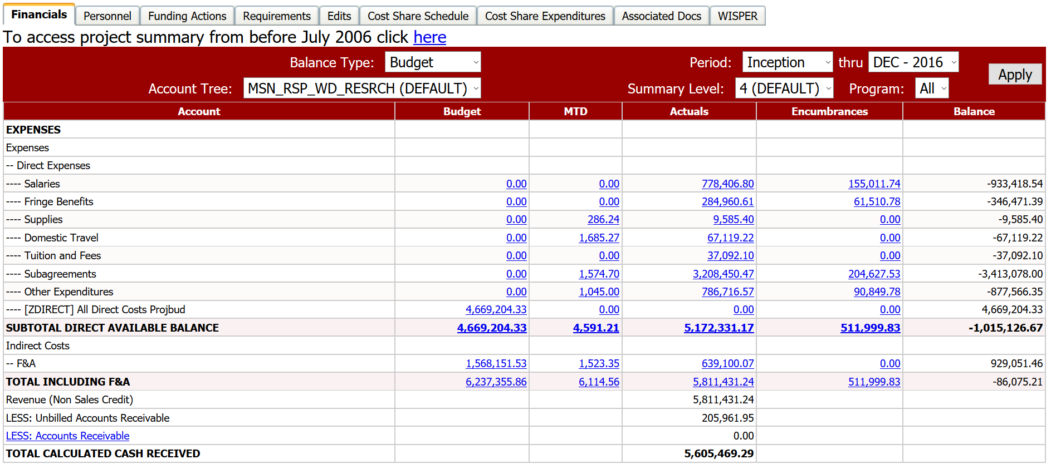
Project Financials– Budget Balance Type
The Budget Balance Type includes Encumbrances. To hide encumbrances, change the Budget Cash Balance Type

Slide 31
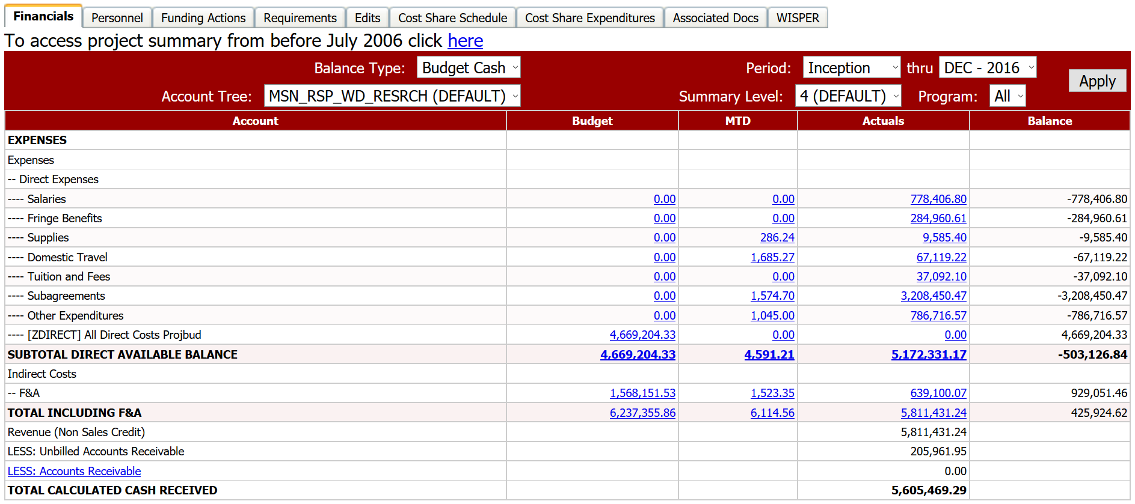
Project Financials– Budget Cash Balance Type
The Budget Cash Balance Type excludes Encumbrances.

Slide 32
Project Financials – Period, Account Tree & Summary Level
Default period is Inception to current accounting period
Account tree will default to the tree that is relevant to the project you are viewing
Summary Level, higher numbers mean more detail. Defaults to Level 4.

Slide 33
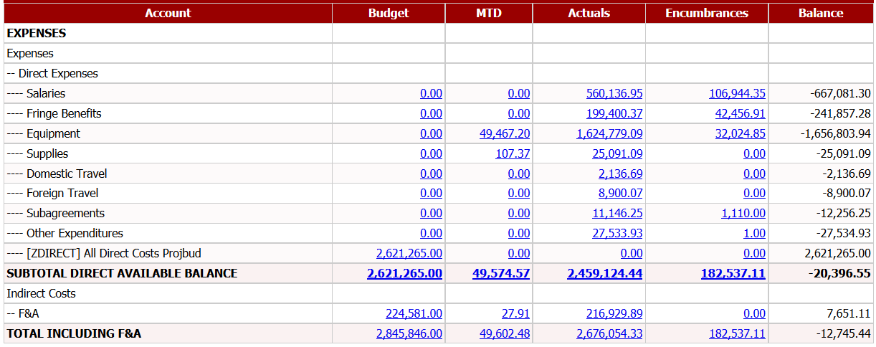
Project Financials – Expense Categories
Account Column defaults to Summary Level 4 Categories; to view account codes below those categories, change Summary Level to 5.

Slide 34
Project Financials – Budget
For most sponsored projects, budgets are not built by individual category, but are divided only between the Total Direct and Total F&A budget as awarded by the sponsor.
This is due to the rebudgeting authority that we receive for most awards.
In those cases, actual expenses can vary somewhat between the original proposed budgets.

Slide 35
Project Financials – MTD (Month to Date)
The MTD column includes those expense that have been posted for the month indicated on the “thru” toggle.
The default “thru” is the current month.
If you are reviewing the MTD for the current month, the month’s expenses have not been fully posted.
Click on the MTD “Total Including F&A” for the Monthly Summary by Expense Type

Slide 36
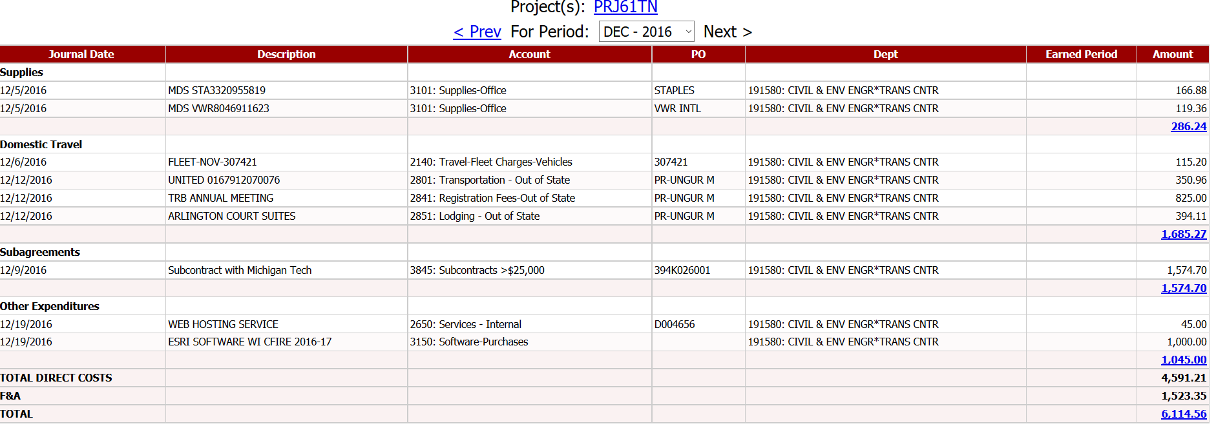
Project Financials – MTD – Summary by Expense Type
This summary page is a valuable tool for
Simplified review
Monthly reporting
Closeout Review – review charges after end date of project
Check for potentially unallowable charges
Additional line details can be found by clicking on the hyperlink totals (by category total, or overall total)

Slide 37
Project Financials – Actuals
The Actuals column indicates the cumulative totals for each category as of the selected “thru” month on the Period.

Slide 38
Project Financials – Encumbrances
Encumbrances
Commitments made, representing expected future actual expenses
Primarily fall into three categories
Salaries and Fringes (for individuals that are planned to be paid on the project)
Purchase Orders for supplies, services, equipment, etc.
Sub-Agreements with other institutions (another research entity that will complete project-related work for the research award)

Slide 39
Project Financials– Direct Available Balance
The available balance to spend on the project is highlighted on the “Subtotal Direct Available Balance” line.
The Balance calculation shown includes Encumbrances as well as Actual expenses (Balance = Budget – Actuals – Encumbrances)
To view the Balance without the Encumbrances, change the Balance Type to “Budget Cash” (Balance = Budget – Actuals)

Slide 40
Project Financials– F&A is separately budgeted
Facilities and Administrative (F&A) costs are budgeted separately from Direct Costs

Slide 41
Accrual Accounting
Accrual accounting recognizes revenue as expenses are incurred
Revenue does not equal Cash
Clinical Trials, Gifts, other non-sponsored projects are managed on a Cash-basis

Slide 42
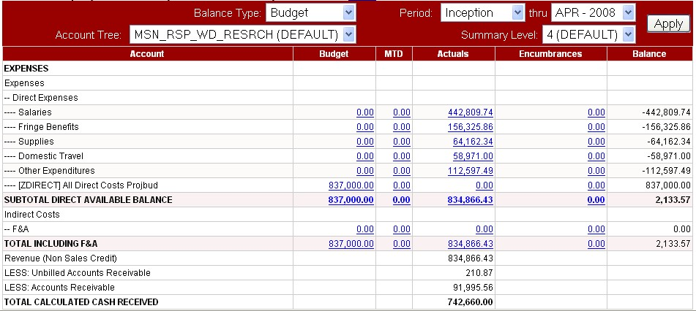
Project Financials– Calculated Cash Received
Cash deposits are not posted at the individual Project ID. To help show the cash received, a formula is used on the bottom of the Financial Summary page.

Slide 43
Project Financials– Calculated Cash Received
Revenue – Unbilled Accounts Receivable – Accounts Receivable = Calculated Cash

Slide 44
Invoicing & Accounts Receivable Information
Accounts Receivable represent Invoices that have been submitted but not yet paid by the sponsor.
Click on the “LESS: Accounts Receivable” hyperlink for additional information on invoices.

Slide 45
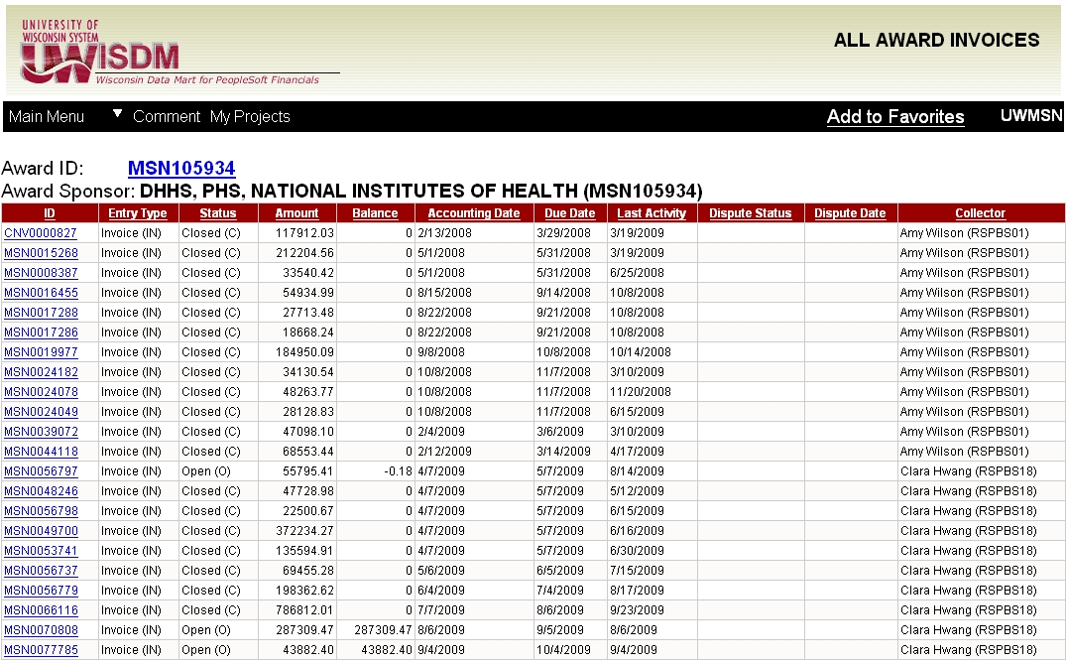
All Award Invoices

Slide 46
All Award Invoices
All Award Invoices page shows every invoice generated for the Award, the amount of the Invoice, Balance of Invoice, Status, etc.
Click on a specific Invoice ID to get additional details on that invoice.

Slide 47
Invoice Activity
Invoice Activity page shows details of a specific invoice: Original Amount, Balance, Status, and the Award which is invoiced.
Payment and adjustment details are shown on the lower section of the screen.

Slide 48
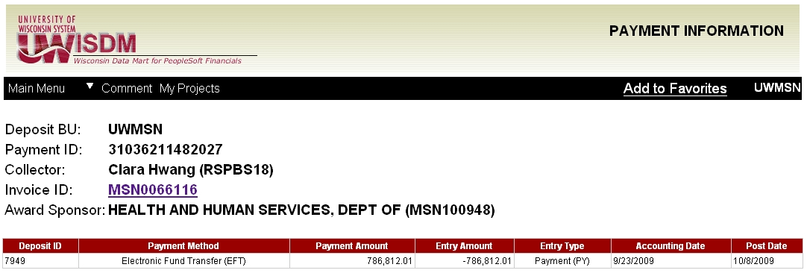
Payment Information
Payment ID hyperlink drills down to specific details of the individual payments against the Invoice.
Click the Invoice ID hyperlink to return to the Invoice Activity page.

Slide 49
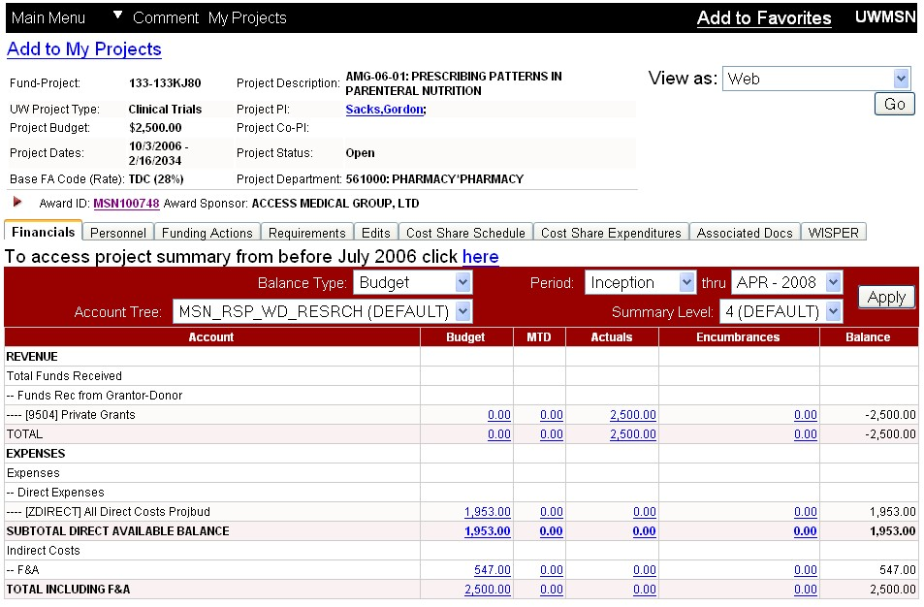
Project Financials– Clinical Trial Cash Received
Cash receipts for Clinical Trials is displayed on the top of the Financial Summary page.

Slide 50
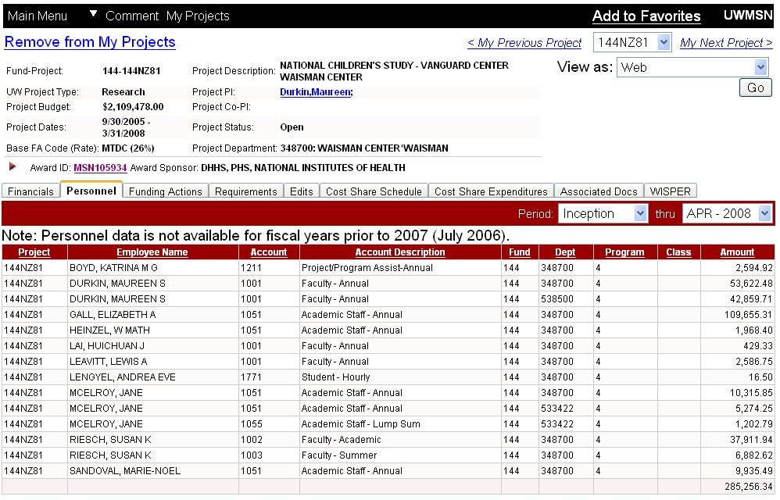
Project Personnel: Individuals Paid Salary or Stipend from Project

Slide 51
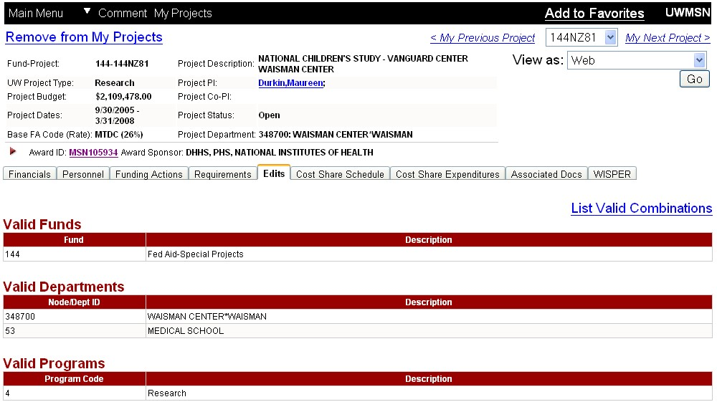
Project Edits: Valid Edit Combinations
You may also validate a specific chart field string by using the Funding Validation/Inquiry Main Menu → Other → Funding Validation/Inquiry

Slide 52
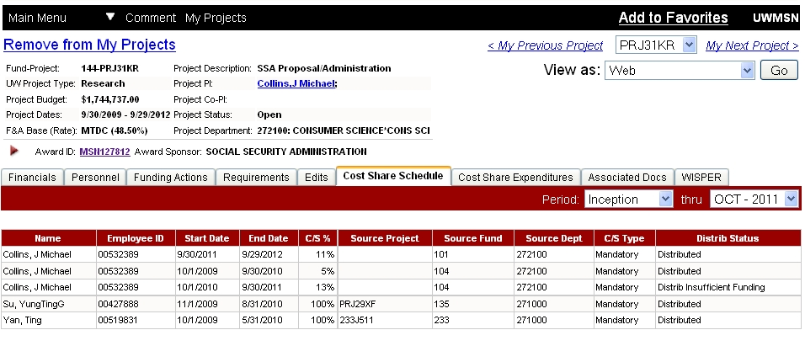
Cost Share Schedule: Cost Share Schedule for Project
Cost share information is listed by person, period of cost share, cost share percent, and source funding.
If the cost share information on this page is incorrect, please fill out cost share form on RSP website: http://www.rsp.wisc.edu/forms/index.cfm

Slide 53
Cost Share Schedule: Cost Share Schedule for Project
The “Distrib Status” column indicates if corrections are made or if there will be potential errors in the calculations.

Slide 54
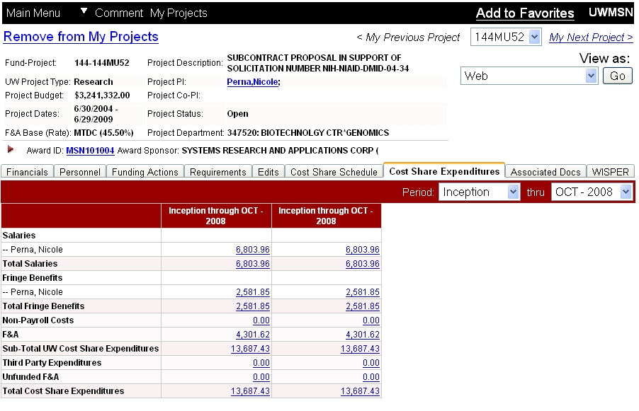
Cost Share Expenditures: details of expenditures meeting cost share schedule

Slide 55
Cost Share Expenditures: details of expenditures meeting cost share schedule
Change the period for which expenditures are displayed
Hyperlinks drill down to details

Slide 56
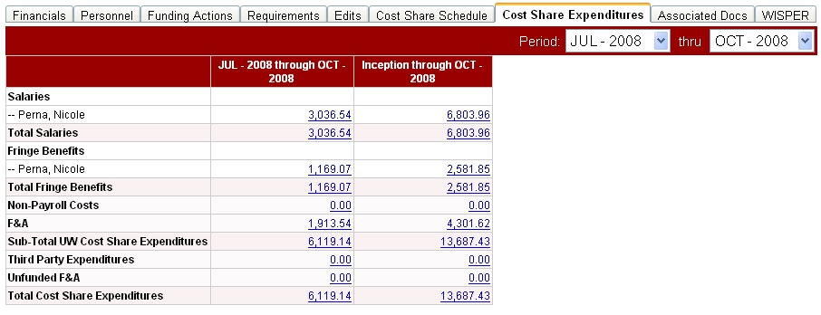
Cost Share Expenditures: details of expenditures meeting cost share schedule
The left column shows the expenditures for the period selected. The right column shows the expenditures from inception through the end period.

Slide 57
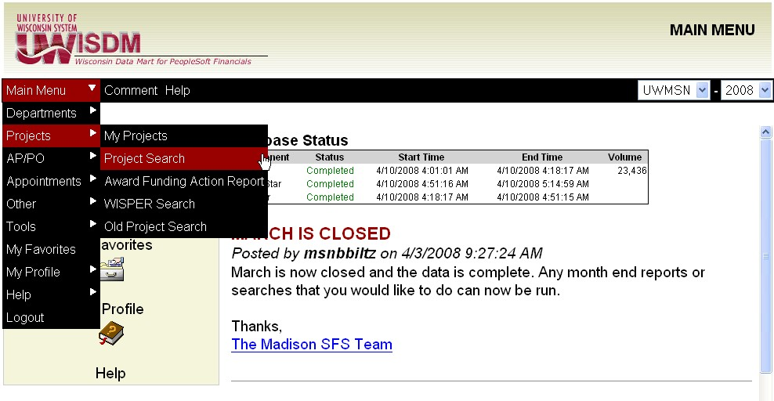
Award/Project Search
The Award/Project Search is accessible from the Main Menu:
Main Menu → Projects →Project Search

Slide 58
Award/Project Search
Enter data in fields to limit number of Awards or Project returned. Results can be on web, Excel, or PDF.
Result layout is the same as the My Projects list.
Result list allows addition/removal from My Projects list.

Slide 59
Award/Project Search
Results list from Awards/Project Search
In My Projects Checkbox indicates if project in search results is already in your My Projects list.
If the box is checked, project is in your My Projects list. To remove, uncheck box. This allows multiple projects to be added/removed from your My Projects list.

Slide 60
Funding Action Search
Returns information on awards received
Can be used for awards received by
PI
Dept
Sponsor
Date range
Also returns other award actions
No cost extension
Budget reallocations
Carry over
Etc.
Gift check deposits are also displayed

Slide 61
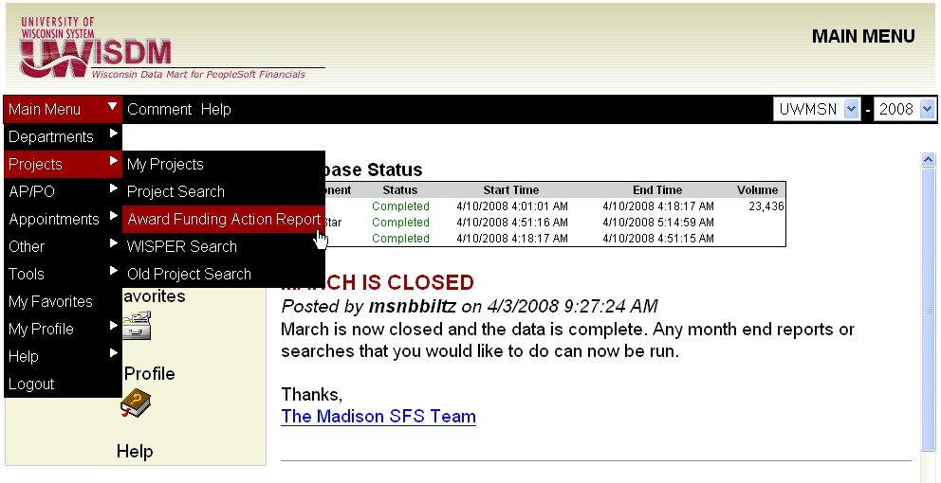
Award Funding Action Report
The Award Funding Action Report is accessible from the Main Menu:
Main Menu → Projects →Award Funding Action Report

Slide 62
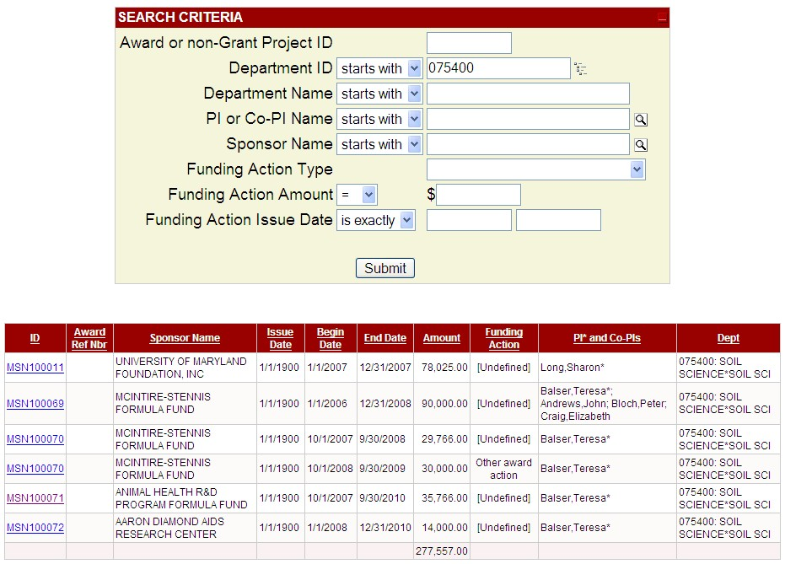
Funding Action Search

Slide 63
WISPER Search
Searches WISPER proposal records received by RSP
For awarded proposals, the WISPER Record ID links to WISDM Award Summary
Many search fields to narrow results

Slide 64
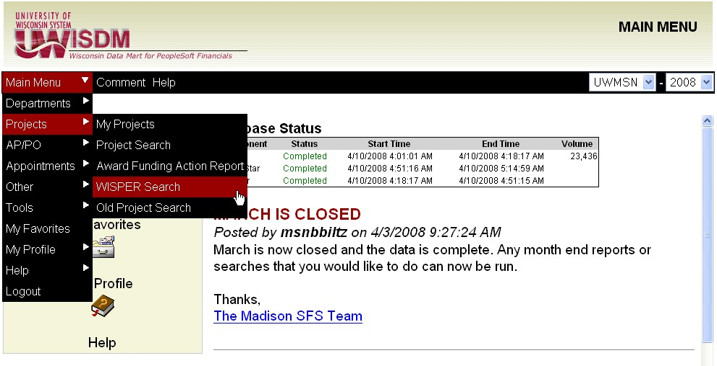
WISPER Search
The WISPER Search is accessible from the Main Menu:
Main Menu → Projects →WISPER Search

Slide 65
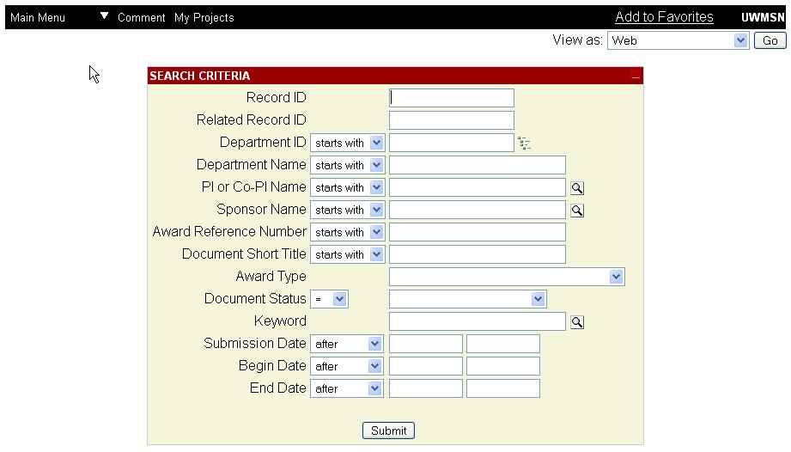
WISPER Search

Slide 66
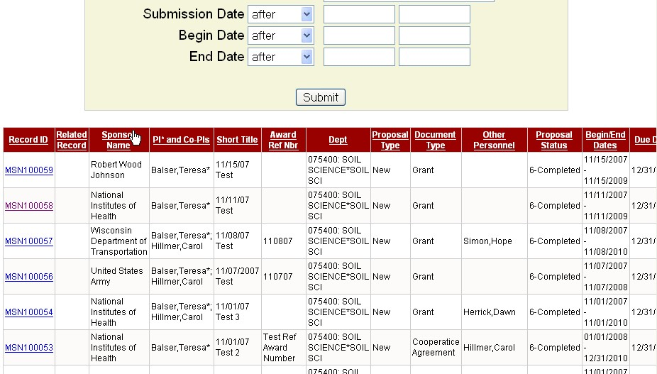
WISPER Search
Drill down to Award and Project information

Slide 67
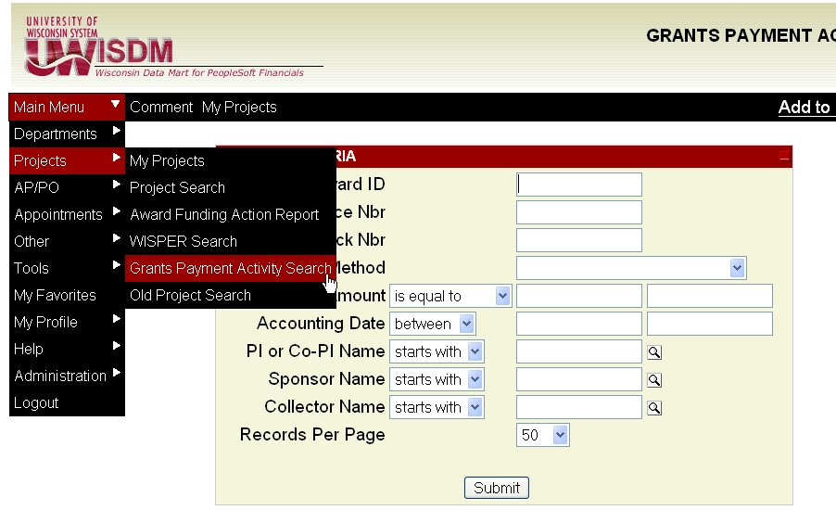
Grants Payment Activity Search
The Grants Payment Activity Search is accessible from the Main Menu: Main Menu → Projects →Grants Payment Activity Search

Slide 68
Grants Payment Activity Search
Searches specific invoices and payments
Search criteria include:
Award ID
Invoice ID
Amount
Check number
PI name

Slide 69
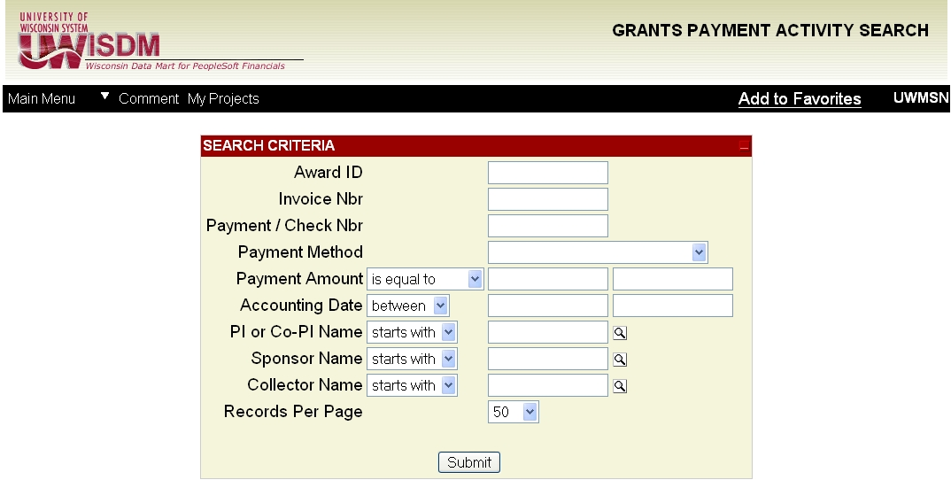
Grants Payment Activity Search

Slide 70
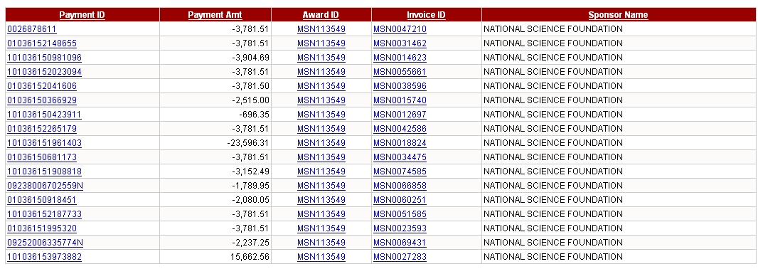
Grants Payment Activity Search: results
Payment ID hyperlink drills down to the details of a specific payment
Award ID hyperlink drills down to the All Award Invoices page
Invoice ID hyperlink drills down to the details of a specific invoice

Slide 71
Resources
Requesting access to WISDM
Download WISDM Authorization Form from: http://www.bussvc.wisc.edu/acct/sfs/wisdm/wisdm2.doc
Submit completed form to: SFS Team, 21 N. Park St, Suite 6101 or fax to 262-5060.
An email will be sent out when authorization has been granted.
Accessing the system: https://wisdm2.doit.wisc.edu
RSP Home Page: https://www.rsp.wisc.edu
Accountant Search: https://www.rsp.wisc.edu/accountant_search/

