Slide 1
WISPER 201
Award Set Up, Commitments, and Cost Share

Slide 2
Award Set Up, Commitment, and Cost Share
Charlie Giese
Senior Grants & Contracts Specialist
Research & Sponsored Programs
Pre-Award, Awards Team
Natalie Benish
Senior Grants & Contracts Specialist
Research & Sponsored Programs
Pre-Award, Awards Team
For WISPER Help
Email: WISPER@rsp.wisc.edu

Slide 3
WISPER-Agenda
WISPER Award Negotiation and Setup Process
WISPER Projects tab
Entering protocols
Entering Project Detail Information
Effort commitments & Cost sharing
PI signature
FCOI confirmation and Final Validation
Advance Accounts
Outgoing Subawards
Additional Resources

Slide 4
WISPER Status 4.5
Document Status 4.5 is used when an award is in negotiation.
RSP has received the award and is reviewing the language. If necessary we will negotiate the terms of the award with the Sponsor. We are reviewing to make sure the language matches Wisconsin State Law, UW Policy and our Faculty interests.
Examples of terms we look for in agreements:
Invoicing
Intellectual property
Publication
Insurance
Confidentiality
For more information on the status of negotiations you can view the SPO Action Tab in WISPER.

Slide 5
WISPER Status 5 – Setup. Projects Tab
WISPER Document Status 5 is used when an award has been received and the language is acceptable for account setup.
We need to Capture DETAILS about how to manage the finances under the award such as:
Federal/Non-Federal Award
Mandatory/Voluntary Committed Cost Sharing
Multiple projects at the time of award
Compliance protocols
Spending edits
Effort commitments
Data can be entered at any time but is required before RSP can generate the Account Number or Advance Account Number

Slide 6
WISPER -Agenda
WISPER Award Negotiation and Setup Process
WISPER Projects tab
Entering protocols
Entering Project Detail Information
Effort commitments & Cost sharing
PI signature
FCOI confirmation and Final Validation
Advance Accounts
Outgoing Subawards
Additional Resources

Slide 7
Projects Tab
When to start?
If RSP receives the award notice first - we will send a “Set-Up Projects” approval to the WISPER Award Setup contact.
If PI or Department receives award notice first:
You can Upload document(s) to Attachments tab, Complete Projects tab and send Setup Projects approval to Division.
OR, email the award to preaward@rsp.wisc.edu

Slide 8
WISPER – Division Implementation
Your Division may have specific instructions on the following items. Please ensure that you communicate with your Division Research Administrators to determine if they recommend any specific method for:
Who will initiate Project Details?
Who will complete Project Details?
WISPER routing path
Use of approvals
Attachments expected

Slide 9
Projects Tab
Projects Tab- What to enter
Award Costs & Dates to match award
If requesting an advance account: enter best known information or $0
Request Multiple Projects if necessary (Subaccounts)
Do you need Multiple Projects?
- The project necessitates separation of budget or accounting by multiple tasks, departments or other factors.
The award incorporates multiple F&A rates (such as NSF grant with REU component).
Separate fiscal periods require separate accounting, billing or fiscal reports (such as NIH P, T, or U mechanisms).
If you are not sure if projects will be needed each year, contact RSP
Add them NOW. RSP will require justification if you ask for them after the award has been generated.

Slide 10
WISPER-Agenda
WISPER Award Negotiation and Setup Process
WISPER Projects tab
Entering protocols
Entering Project Detail Information
Effort commitments & Cost sharing
PI signature
FCOI confirmation and Final Validation
Advance Accounts
Outgoing Subawards
Additional Resources

Slide 11
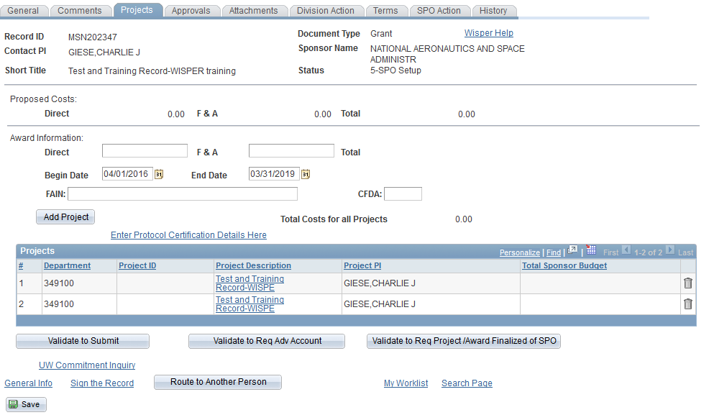
WISPER – Protocol Details
Protocol Details
For any Compliance question to which you responded yes at proposal stage…

Slide 12
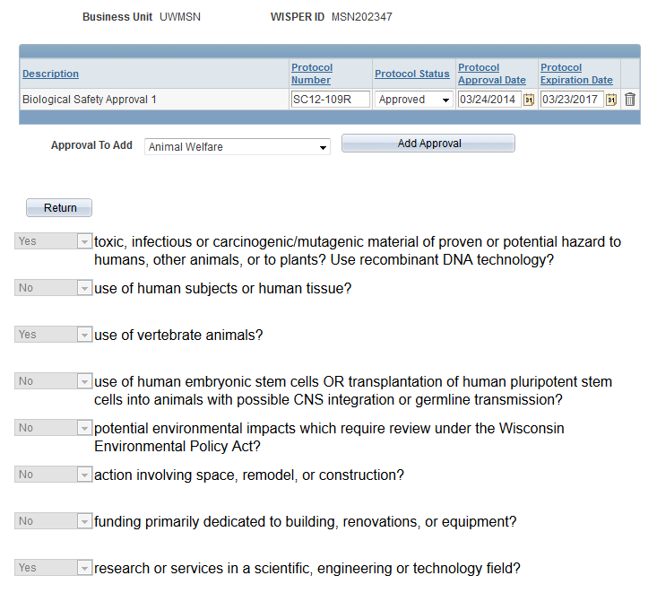
WISPER – Protocol Details
The protocol must be approved & valid. Enter under the Details link.
For exempt IRB: Check Yes on the General Page. Enter the protocol number, approved status, date approved and expiration date of 12/31/2099.
For WIRB: Upload a copy of the approval as an attachment.

Slide 13
WISPER – Protocol Details
Enter IRB, IACUC, biosafety, and stem cell protocol approval information in WISPER
Protocol must specifically list this award as a funding source (MSN#, Sponsor#, Title, etc.)
Special Instructions for NIH Training Grants:

Slide 14
WISPER-Agenda
WISPER Award Negotiation and Setup Process
WISPER Projects tab
Entering protocols
Entering Project Detail Information
Effort commitments & Cost sharing
PI signature
FCOI confirmation and Final Validation
Advance Accounts
Outgoing Subawards
Additional Resources

Slide 15
WISPER – Project Details
Project Details – Necessary Info
Description–Use this for your own Reference
(It will appear in reports and WISDM.)
Senior Personnel
Enter Project PI(check Project PI box)
Enter other key personnel that were proposed as key
Project Type Research(GM_10), Public Service(GM98), etc.
Fund Code
144 Federal/Federal pass-through or
133 Non-Federal
Owning Department – Responsible for award
Project Dates - Start & End

Slide 16
WISPER – Project Details
F&A Information
F & A Rate Type – Research, Instruction, Public Service, Off-Campus
FA Base– MTDC, TDC
FA Rate - % recovered from Sponsor
Combo Edits
Allowing People to Spend on the Account
Single or Multiple Departments
Nodes: Allowance of spending for a range of departments (ex. 5367 allows all sub-departments starting with these numbers)
Program Codes
Reference: http://www.uwsa.edu/fadmin/activity/
Budget Details
Direct/F&A, Category, or NIH Training Grant
If Advance Account, we can leave these as $0

Slide 17
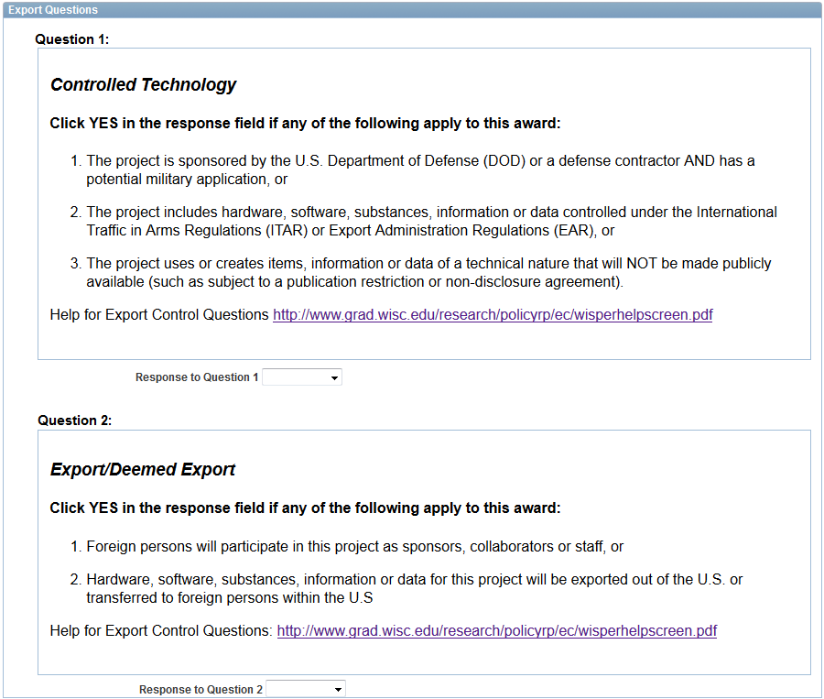
WISPER - Project Details
Export Control Questions
Contact Export Control Office for help
https://www.rsp.wisc.edu/awardsetup/exportcontrols/
exportcontrol@grad.wisc.edu

Slide 18
WISPER-Agenda
WISPER Award Negotiation and Setup Process
WISPER Projects tab
Entering protocols
Entering Project Detail Information
Effort commitments & Cost sharing
PI signature
FCOI confirmation and Final Validation
Advance Accounts
Outgoing Subawards
Additional Resources

Slide 19
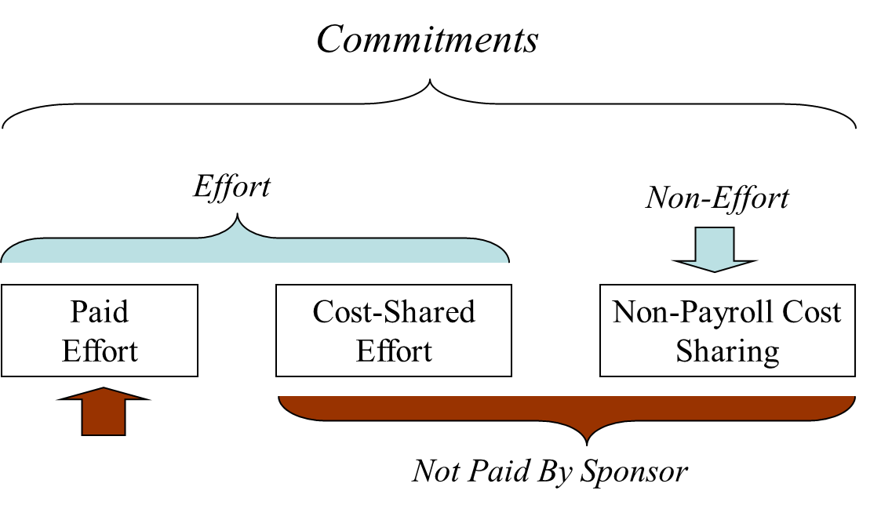
WISPER - Effort and Cost-Share

Slide 20
WISPER – Effort Resources
Effort
RSP Effort Page: https://www.rsp.wisc.edu/effort/
Award Set-up Specifics: https://www.rsp.wisc.edu/awardsetup/
Notes:
This page is the resource for all UW effort information. Links to Policy, Training, Instructions on how to certify, videos, calendar.

Slide 21
Effort Certification
Effort Certification: Required by Federal Regulation and University policy.
Effort Certification is the UW’s means of:
Providing assurance to Sponsors that faculty and staff have met their commitments
Confirm salaries charged to sponsored projects are reasonable in relation to the work performed
Effort Certification is done through ECRT but we use WISPER to confirm Effort Training and Certification requirements are met.

Slide 22
Commitments
Commitments are made at Proposal Stage
Where: Budget, Budget justification, SOW (if specific & quantified)
What: The quantified amount of time proposed in a grant proposal or other project application

Slide 23
Commitments
Who has a commitment?
Everyone, and Anyone, listed in a proposal with a specific and quantified amount of time proposed.
If no commitments are proposed in the grant application, UW effort guidelines state that the contact PI must have minimum of 1% effort commitment
Based on 2001 OMB memo, and referenced in the Uniform Guidance
Exceptions to the minimum PI commitment rule: Equipment or instrumentation grants, doctoral dissertation grants, and student mentoring grants, clinical trails
UW policy, faculty cannot commit 100% of their time on sponsored projects. Time must be reserved for other UW duties.

Slide 24
Commitments
What does the UW track at Award Set-up?
Effort commitments only for those individuals identified in the award document.
Typically the just the PI, or other senior/Key Personnel
Exceptions: Fellowships, equipment, financial aid, clinical trials, doctoral dissertation grants, and student mentoring grants
If the award document does not specifically identify PI, Co-PI, or Key Personnel, effort commitment will be tracked for the contact PI only.
This practice does not diminish the scientific contribution to the project of other senior/key personnel; it merely limits the number of individuals that are affected by the effort-related prior approval requirement to those specifically named in the NoA.

Slide 25
Commitments
Why UW only tracks those on NoA?
Uniform Guidance (2 CFR 200), provided an opportunity for UW-Madison to review its effort policies and procedures.
Prior approval is required for a reduction of 25% or more in the level of effort for senior/key personnel named in the NoA.
Those not listed in the NoA may adjust their commitment without prior approval.
Seeks to take advantage of flexibilities provided by Uniform Guidance to reduce administrative burden
https://www.rsp.wisc.edu/effort/Guidance_Treatment_Effort_Commitments.pdf

Slide 26
Commitments
What if my budget is cut?
Commitment is the quantified amount of effort proposed that the sponsor accepts and awards, regardless of salary support.
Sponsor reductions in budgets do not mean the Sponsor accepts a reduction in effort.
Options for dealing with budget cuts:
Keep salaries & effort the same as proposed; reduce other budget categories (travel, supply etc.)
Keep effort the same, reduce salaries – document the increased cost share
Reduce effort commitments – prior approval needed from sponsor if reduction is greater than 25% for those in NoA.

Slide 27
Effort Certification
Effort Requirements for Account Set Up:
All Key Personnel must complete Effort Training
Required Certifications must be complete
PI must certify effort for self and staff (graduate students, postdocs & classified staff)
Key Personnel must certify for self
Note: RSP will not set up awards if any key personnel on an award have not met Effort Requirements.
A validation warning in WISPER if Key Personnel have not met requirements.
WISPER General Tab and Projects Tab have a help icon that provides a link to RSP ECRT page for help.
If questions- Please contact your Department Effort Coordinator.

Slide 28
Cost Sharing
Cost Sharing: The portion of the total costs of a sponsored project that is borne by the UW rather than the sponsor.
University's policy is to minimize institutional and third party cost sharing on sponsored projects. Should only be included in proposal when necessary.
Salary Cost Share: Occurs on a sponsored project when the University, not the sponsor, provides salary support for an individual's time on that sponsored project.
Collected at Award Set-up. Can be entered later if needed.

Slide 29
Types of Cost Sharing
Mandatory Cost Share: Cost sharing that is required by the sponsor as a condition for proposal submission and award acceptance.
Voluntary Cost Share: Cost sharing that is offered in a proposal’s budget but not required by the sponsor as a condition of proposal submission. Once offered by the institution and agreed to by the sponsor, it becomes an obligation the university must fulfill.
Mandatory
Mandatory
Voluntary
Unavoidable
Examples: PI’s minimum 1%
Critical to support the research enterprise
Example: Small awards where PI’s salary would be too great a
portion of the awarded amount
Offered “just because”

Slide 30
Cost sharing
Uniform Guidance, § 200.306: Cost Sharing or Matching:
“Under Federal research proposals, voluntary committed cost sharing is not expected.”
“Criteria for considering voluntary committed cost sharing and any other program policy factors that may be used to determine who may receive a federal award must be explicitly described in the notice of funding opportunity.”

Slide 31
Commitments & Cost Share
At Award Set Up:
Commitments only entered for those on NoA
Look at award to identify personnel
Then look at proposal to identify level of commitment
Enter commitment into WISPER projects tab
Paid or Cost Shared
All key personnel should be up to date with effort tasks (training and certification) before award can be set up.

Slide 32
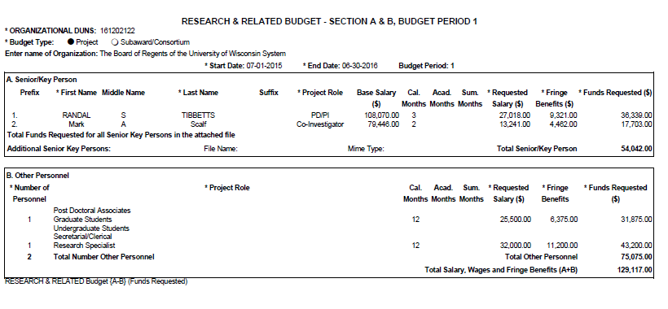
WISPER – Effort Commitment Entry, A-basis, Sponsor Paid
Example 1
Professor PI has promised 3 calendar months to the project in Year 1
3 calendar months = 25% effort commitment whether or not salary is being requested

Slide 33
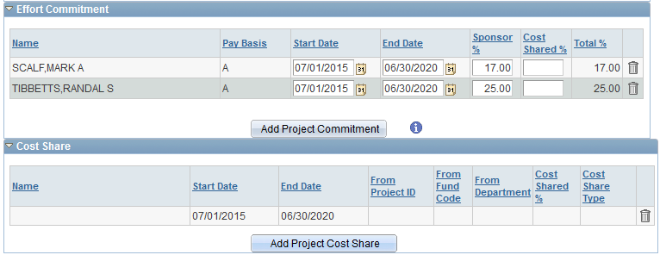
WISPER – Effort Commitment Entry, A-basis, Sponsor Paid
One Commitment – Constant, paid by Sponsor, A-basis appointment. Enter aggregate.
Year 1 -5: Start = 7/1/15. End =6/30/20.
3 Calendar Months: Commitment = 25%
2 Calendar months: Commitment = 16.67% rounded to 17%

Slide 34
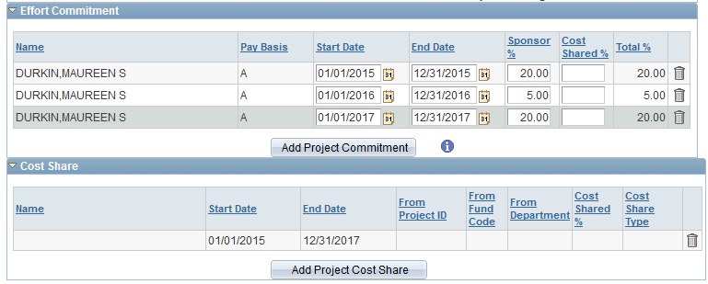
WISPER – Effort Commitment Entry, A-basis, Sponsor Paid
Example 2
Multiple periods – Not constant, paid by Sponsor, A-basis appointment. Enter each commitment period separately:
Year 1: Start = 1/1/15. End =12/31/15. Commitment = 20%
Year 2: Start = 1/1/16. End= 12/31/16. Commitment = 5%
Year 3: Start = 1/1/17. End =12/31/17. Commitment = 20%

Slide 35
WISPER – Effort Commitments
Summer Commitments – Academic (C or 9 month) Appointees
Typically, budgets list “1 summer month” or “2 summer months” without identifying which month(s).
Check with your Dean’s office for method to use.
You may opt to enter summer effort for the summer period only:
1 summer month: 33% from 6/1 – 8/31
2 summer months: 67% from 6/1 – 8/31
This method enables us to know that an individual is not overcommitted for the summer months
You may opt to enter summer effort over the total calendar year:
1 summer month: 1/12 = 8%
2 summer months: 2/12 = 17%
Either method can be used as long as all commitments for all projects for that individual are entered using the same method from above

Slide 36
WISPER – Cost Share Payroll Commitments
If you are cost sharing, you must be careful while setting up the Project details.
An appropriate source of funding should be used to provide the cost share.
C-basis appointees are typically only paid on 101 funds during the academic year.
If using 101 funds for C-basis appointees, cost share should be set up only during academic year, 9/1-5/31.

Slide 37
WISPER – Effort Commitment, A-basis, Sponsor Paid & Cost Shared
Example 3

Slide 38
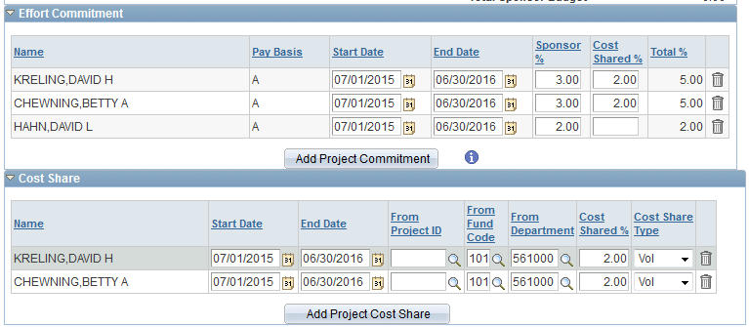
WISPER – Effort Commitment, A-basis, Sponsor Paid & Cost Shared
3. One Commitment – Paid partly by Sponsor and cost shared by University, A-basis appointment.

Slide 39
WISPER – Effort Commitment, C-basis
Example 4

Slide 40
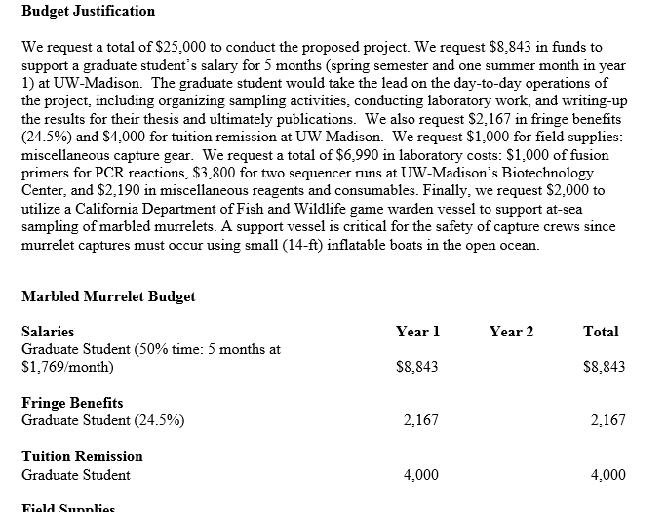
WISPER – Effort Commitment, C-basis, Sponsor Paid & Cost Shared

Slide 41
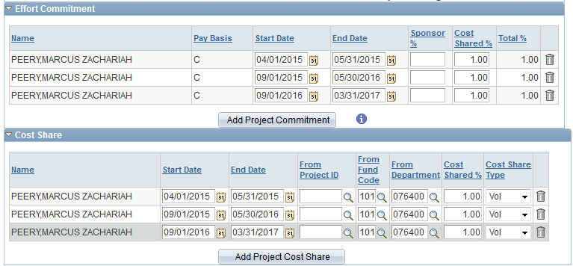
WISPER – Effort Commitment, C-basis, Cost Shared
4. One Commitment –Cost shared by University, C-basis appointment.

Slide 42
The Effort Process in a Nutshell:
Commitment Proposed
Commitment Awarded
WISPER
SFS Commitment Management
ECRT
Effort expended by PI
Commitment met

Slide 43
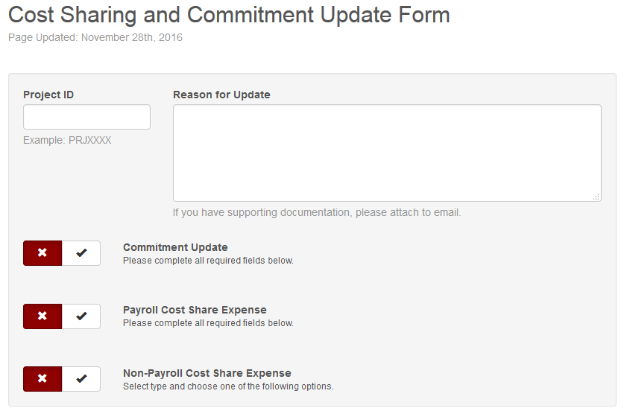
WISPER – Commitment Changes
Changes
http://www.rsp.wisc.edu/forms/costshare.pdf
You must check the appropriate box first. Then appropriate questions will appear below. Send completed forms to Dean’s office, who will route to RSP.

Slide 44
WISPER-Agenda
WISPER Award Negotiation and Setup Process
WISPER Projects tab
Entering protocols
Entering Project Detail Information
Effort commitments & Cost sharing
PI signature
FCOI confirmation and Final Validation
Advance Accounts
Outgoing Subawards
Additional Resources

Slide 45
WISPER – PI Signature
Link is only available for those listed as PI
Link at the top of the General tab & the bottom of all other tabs
Award Signature must be completed before the request to set up the advance award or finalize set up of the projects.
Know whether the PI has signed by clicking on the Request signature button on the General Tab or looking in the Document History
(request using button on General Tab if needed)

Slide 46
WISPER – PI Signature

Slide 47
WISPER – PI Signature

Slide 48
WISPER – PI Signature

Slide 49
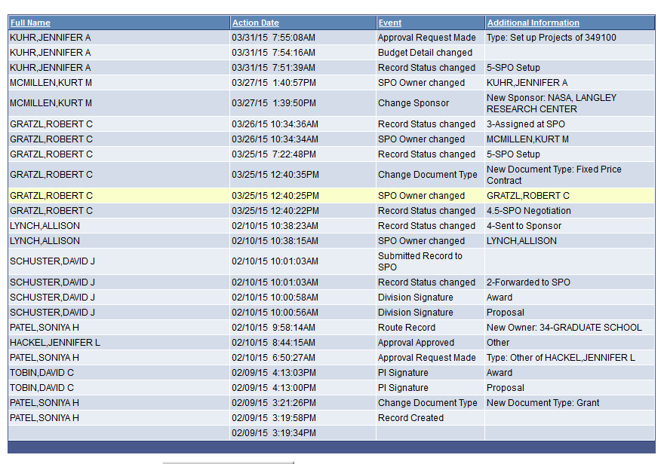
WISPER – PI Signature
PI signature on History tab

Slide 50
WISPER-Agenda
WISPER Award Negotiation and Setup Process
WISPER Projects tab
Entering protocols
Entering Project Detail Information
Effort commitments & Cost sharing
PI signature
FCOI confirmation and Final Validation
Advance Accounts
Outgoing Subawards
Additional Resources

Slide 51
FCOI Compliance
At award set up RSP checks to ensure all key personnel are up to day with FCOI tasks
University COI Policy:
All Key Personnel required to have a valid annual OAR on file to receive RSP award set-up services
Annual OAR submissions are due May 1st of each year
This is indicated on the General Tab of each WISPER record.
PHS FCOI Policy:
All Key Personnel as listed in the proposal will need to complete FCOI training.
All Key Personnel will need to update their OAR at time of Award Set Up.
Agencies Using the PHS FCOI Regulations: http://sites.nationalacademies.org/PGA/fdp/PGA_070596

Slide 52
University FCOI Compliance
All PI/Co-I and Key Personnel required to have a valid annual OAR on file to receive RSP award set-up services
Annual OAR submissions are due May 1st of each year
This is indicated on the General tab of each WISPER record.
Here:
And Here:

Slide 53
PHS FCOI Regulations
http://www.gpo.gov/fdsys/pkg/FR-2011-08-25/pdf/2011-21633.pdf
http://grants.nih.gov/grants/policy/coi/
All PI/Co-I and Key Personnel identified in the proposal for a PHS award will need to complete FCOI training.
All PI/Co-I and Key Personnel will need to update their OAR at time of Award Setup.
*OAR updated within the last 30 days of record being added into FAST

Slide 54
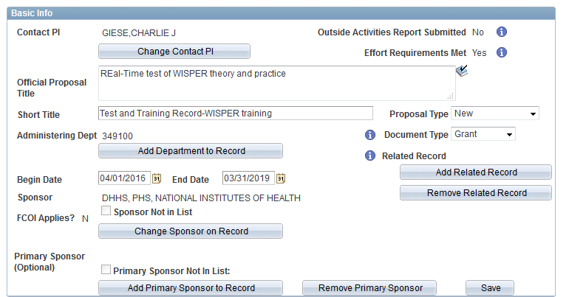
PHS FCOI Compliance
Agencies Using the PHS FCOI Regulations: http://sites.nationalacademies.org/PGA/fdp/PGA_070596
This is also reflected in WISPER

Slide 55
PHS FCOI Compliance
Process for FCOI Check
Key personnel are identified by RSP and loaded into the personnel section of the General tab in WISPER
Record is then loaded to FAST by (FCOI Award Setup Tool)
Key personnel are notified via email and instructed to complete FCOI requirements. Department contact is also copied on this e-mail.
FAST tracks and logs FCOI items in compliance and emails RSP when items are completed
Only when all items are completed will RSP move forward.

Slide 56
FCOI Compliance
FAST: https://my.gradsch.wisc.edu/coi-rsp/setupListView.pl
Has search options
Separated by awards that have pending clearance, reports to submit, and awards ready for set up
By selective the specific record you can see all items not completed and who needs to complete them
Key personnel need to have FCOI training completed and OAR updated within the last 30 days of record being added into FAST
If key personnel have any reportable items they will work with the COI office to address them and develop a management plan if needed
RSP will submit all reports to the sponsor if necessary

Slide 57
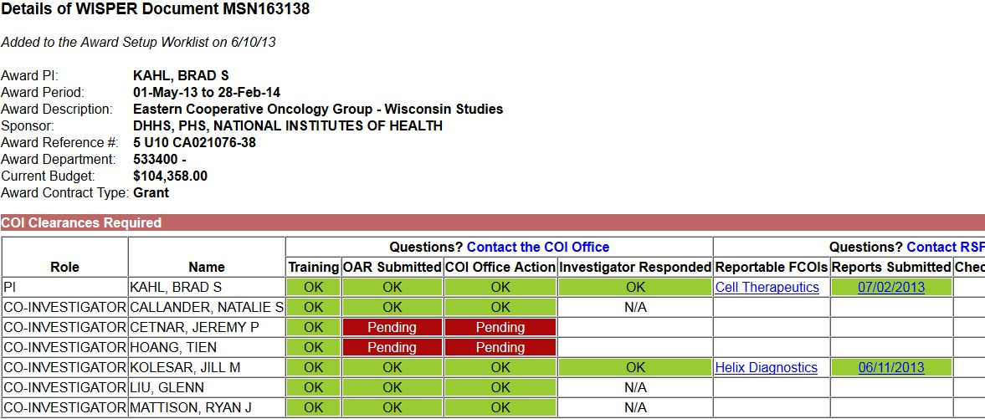
PHS FCOI Compliance
FAST: https://my.gradsch.wisc.edu/coi-rsp/coiDashboard.pl

Slide 58
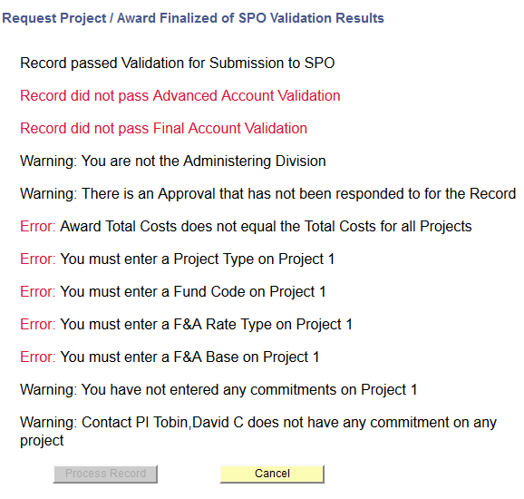
WISPER – I’ve Completed Project Entry
Validate!
If RSP sent you an approval, respond to it.
Make sure to click “Validate” button prior to responding to the approval. Correct any errors. Errors appear in RED

Slide 59
WISPER Account Setup Completion
When validation is complete and the project is ready for setup- approve the original Setup Projects Approval request from RSP.
RSP will review the WISPER record and generate the project number.
The WISPER record will be switched to Status 6 and locked. The award and project information will be visible in WISDM the following day.
https://wisdm2.doit.wisc.edu/wisdm2/Main.aspx

Slide 60
WISPER-Agenda
WISPER Award Negotiation and Setup Process
WISPER Projects tab
Entering protocols
Entering Project Detail Information
Effort commitments & Cost sharing
PI signature
FCOI confirmation and Final Validation
Advance Accounts
Outgoing Subawards
Additional Resources

Slide 61
WISPER – Advance Accounts
Request Advance Account Setup
Projects to be set up in advance of the award a) being received or b) fully executed.
Complete all information on Projects tab
Validate!
Add approval REQUEST ADVANCE AWARD SETUP to your Division
Division then notifies RSP via Division Action page
The day after advance award set up is completed, an email notification is sent to those on Department email contacts list. Check Document History if you are not listed.

Slide 62
WISPER-Agenda
WISPER Award Negotiation and Setup Process
WISPER Projects tab
Entering protocols
Entering Project Detail Information
Effort commitments & Cost sharing
PI signature
FCOI confirmation and Final Validation
Advance Accounts
Outgoing Subawards
Additional Resources

Slide 63
WISPER- Outgoing Subawards
RSP is notified that an award includes subaward activity by the Subaward Question on the WISPER General Tab.
When a record is completed an automated email is sent to the campus contact, and the PI, with instructions for having the sub-award issued.
Departmental personnel will need to submit a request via the sub-award portal to RSP for sub-award issuance.
RSP will complete an internal risk assessment and determination prior to issuance and work with the Department if questions arise.
For more info: https://www.rsp.wisc.edu/awardmgt/subagmts.cfm

Slide 64
WISPER-Agenda
WISPER Award Negotiation and Setup Process
WISPER Projects tab
Entering protocols
Entering Project Detail Information
Effort commitments & Cost sharing
PI signature
FCOI confirmation and Final Validation
Advance Accounts
Outgoing Subawards
Additional Resources

Slide 65
Help?
If you need help, try the following steps:
Click on the help icon next to the field in question
Click on the WISPER Help link on the top of each page
Contact the SPO Owner (see SPO Action tab)
Consult the WISPER help page at: http://www.rsp.wisc.edu/WISPER/ for
Training Manual
Desk References
Webcasts
This presentation
Email: WISPER@rsp.wisc.edu

Slide 66
Resources
Award Set-up Web-Page:
https://www.rsp.wisc.edu/awardsetup/
Commitment Lookup Tool:
https://www.rsp.wisc.edu/effort/lookup/comlookup/index.cfm
UW Effort Policy
http://www.rsp.wisc.edu/effort/uwMadisonEffortPolicyFINAL2007-08-29.pdf
UW Effort Guidelines:
http://www.rsp.wisc.edu/effort/uwMadisonEffortGuidelines2008-03-19.pdf
Outgoing Subawards
https://www.rsp.wisc.edu/awardmgt/subagmts.html

Slide 67
WISPER – Feedback & Questions
Questions?
Thank you for coming!
Charlie Giese Charlie.Giese@wisc.edu
Natalie Benish Natalie.Benish@wisc.edu

